Slide 1
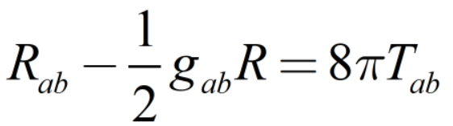
General Relativity Visualization
Zhihao Xu

Slide 2

Notations
In this presentation, to explain and express things in details, we are going to introducing abstract index notation(those latin sub/super scripts):
start from our most familiar vectors:

Slide 3
Client:
<a tautological reference>
Client Satisfaction level:
4/10
At least it is functioning after combine all kinds of element
It does a fair job on simulating geodesics(lightrays) in curved spacetime
Very life changing(i.e. make me stay up late debugging and questioning myself)
Toooooooo many functionalities has to be suspended
My lovely constructed progress bar isn’t showing😡

Slide 4
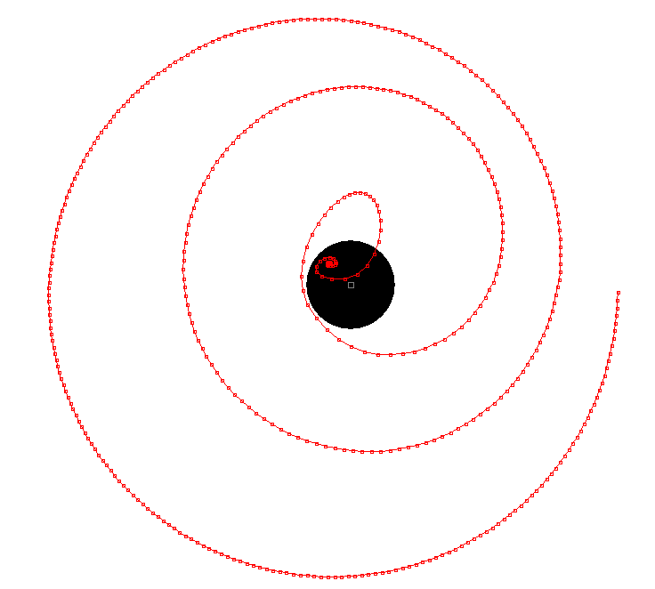

General useages
Showing how geodesics works in arbitary configuration
Comparing different numerical methods for solving differential equations
Practing tensor calculation skills
etc.

Slide 5
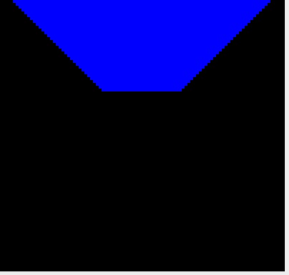
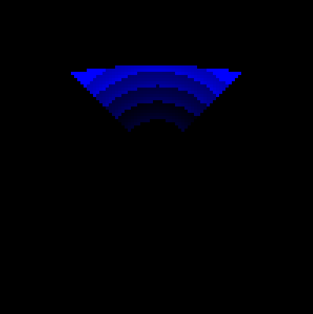
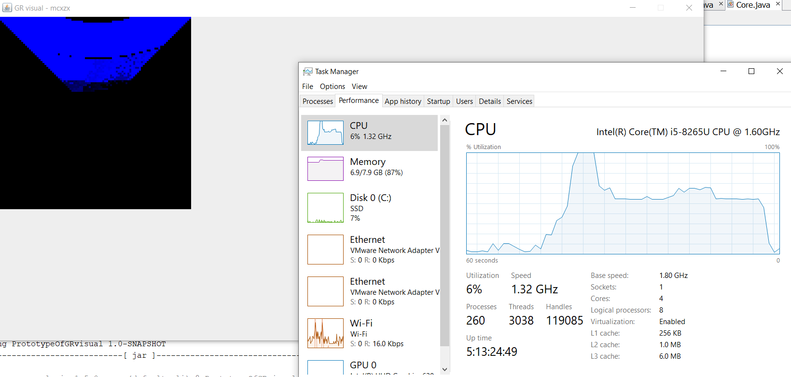
General useages
See the gravitational lenzing effect
Droppler shift effect
Torrel rotation effect
Relativistic aberration effect
…
Could nicely visualizing these phenomena,
for educational and art purposes

Slide 6




API used
Mostly on NetBeans with java
Aparapi kernel
Used for rendering using GPU but failed because of the unsupportbility after graphics driver been updated
JLaTeXMath
Used for rendering latex in the program. Not yet been used since I wasn’t yet able to make a latex interpertator

Slide 7
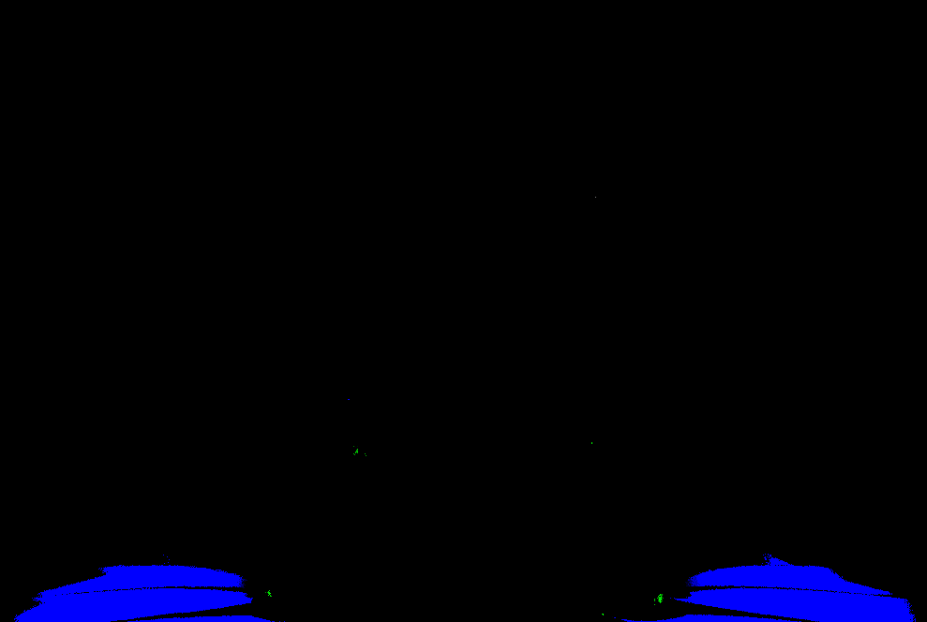
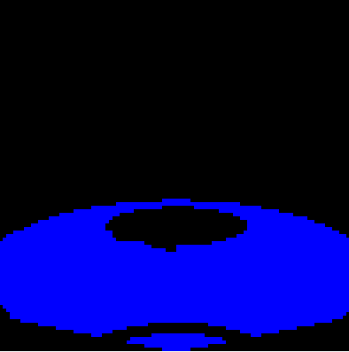
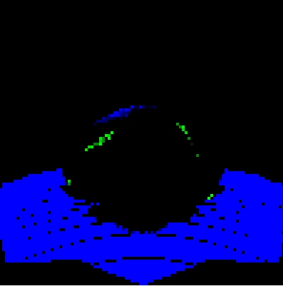
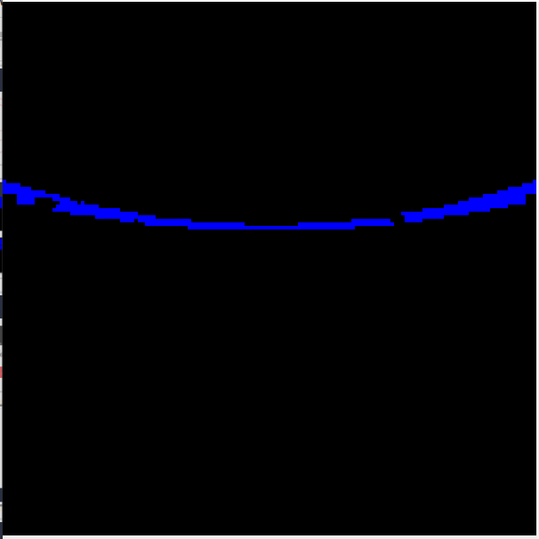
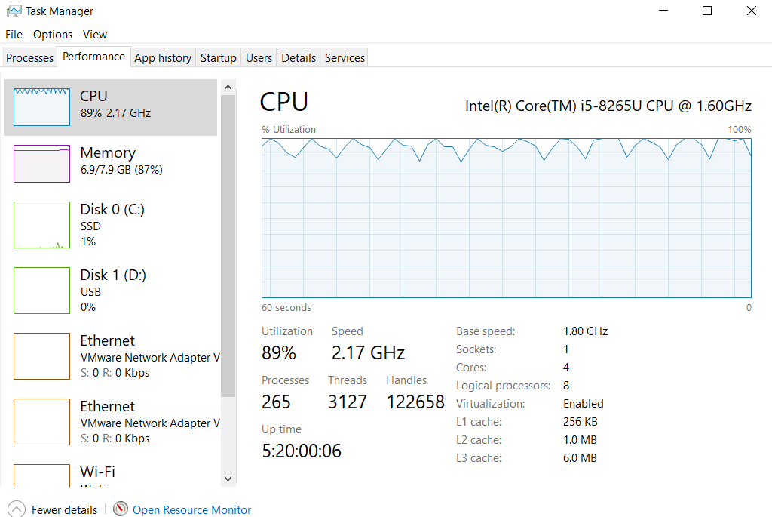
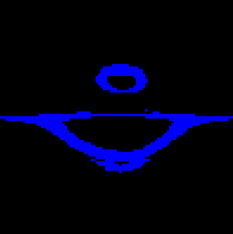
Show case

Slide 8
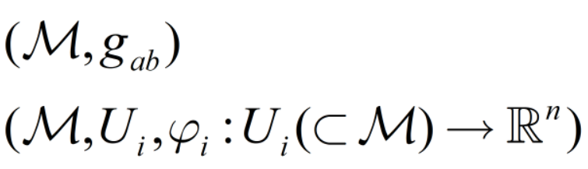
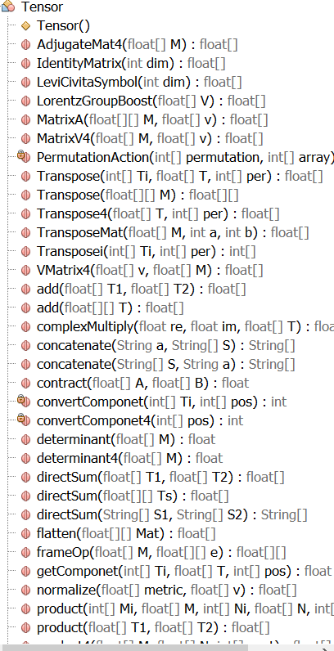
Chanllanges faced(facing)
Build manifold
Tensor operations(efficency consideration)
Object system(complexity reduction)
Light physics
Light here cannot be regard as RGB any more. It is composed by light of different wavelengths. So I made WColor(which stores the density of light at each wavelength)

Slide 9
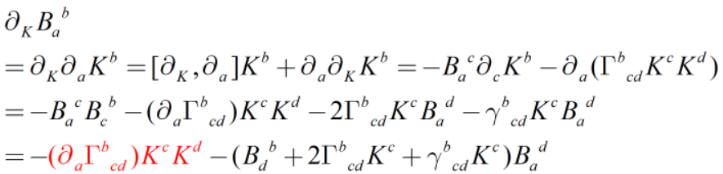
Chanllanges faced(facing)
The non stability of the frame of reference tensor(a linear transformation corresponding to the connection of “translating” along the flow generated by frame of reference K) evolution equation:
Equation is definitely right
works perfect in flat spacetime
but the red part make the
whole thing diverge pretty
quickly in non-flat spacetime due to inaccuracy in the numerical simulation.
Finally has to give up evaluating this tensor
Mabe I can used a linearized version to solve the problem some other time

Slide 10
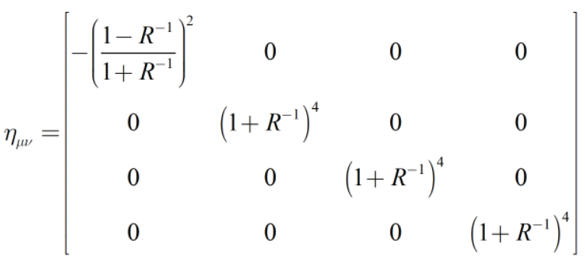
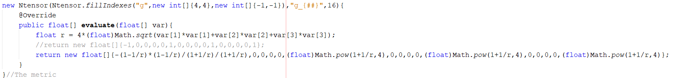
Chanllanges faced(facing)
evaluating LaTeX expressions is another thing which is very hard for me and I’m not yet able to implement it.
It has to evaluate LaTeX into a function Object(NFunction in the program)
This whole thing can only be user friendly software(instead of a engine API) after this is done

Slide 11
Things I learned
Some more java intrinsic properties(only primary value are not pointers. This makes the language more complete but also more complicated while dealing with objects copying manipulating compareing etc.)
How to write a GPU useable program using aparapi kernel
SDLC methods and actual processes
New ideas of rendering spacetime, and more solid understanding of there underlying equations
Understanding of numerical differential equation solving (Runge Kutta)
Higher order corrections of light in spacetime

